Slide 1
FDP on Agentic AI: Foundations, Applications, and Future Directions
“Exploring the Power of Agentic AI with IBM Granite and LangFlow”

Slide 2

Name of the team: SKYMINDS
Details of Team members
TEAM MEMBER NAME | Recent Passport Photo | Email ID | Phone number [WhatsApp]
Aniket Thakur |  | aniket.r.thakur@gmail.com | 9021376289

Slide 3

AI agent for chronic disease monitoring
The Challenge
An AI agent for chronic disease monitoring helps patients and healthcare providers manage long-term conditions effectively.
It continuously analyzes health data from wearables, medical records, and patient inputs to detect early warning signs.
Using AI and predictive analytics, it offers personalized insights, medication reminders, and lifestyle recommendations.
The agent supports diseases like diabetes, hypertension, and heart conditions with real-time monitoring and alerts.
It enables proactive care, reduces hospital visits, and improves patient adherence to treatment plans.
This intelligent assistant bridges the gap between patients and providers, enhancing chronic care outcomes.

Slide 4

We are going to use Langflow platform .

Slide 5
Solution Overview
Build an AI agent using Langflow to integrate wearable sensor data, medical records, and patient-reported inputs into a unified monitoring pipeline.
Apply predictive analytics and anomaly detection models to identify early warning signs of chronic disease complications.
Provide real-time alerts, medication reminders, and personalized lifestyle recommendations to patients and healthcare providers.
Enable continuous risk assessment and progress tracking through an interactive conversational interface powered by Langflow agents.
Improve patient adherence and reduce healthcare burden through automated insights and seamless communication between care teams and patients.

Slide 6
Langflow component Used
Explain the use of each langflow component used into you project
1)Chat Input – I am Chronic Disease Agent. Ask me any question about HighBP , Sugar or any Chronic Disease?
2) IBM watsonx AI Agent
File component : A pdf on Chronic Diseases “Diabetes and Hypertension”
Chat output
Add name of any other component used.

Slide 7
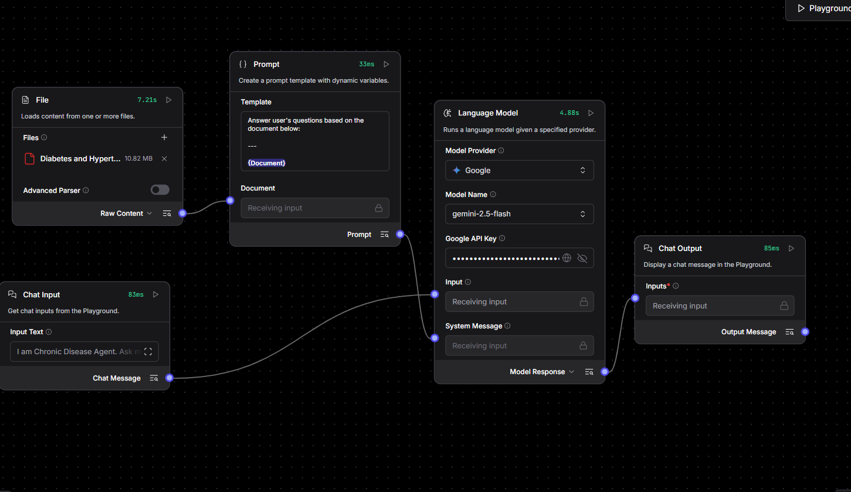
Workflow

Slide 8
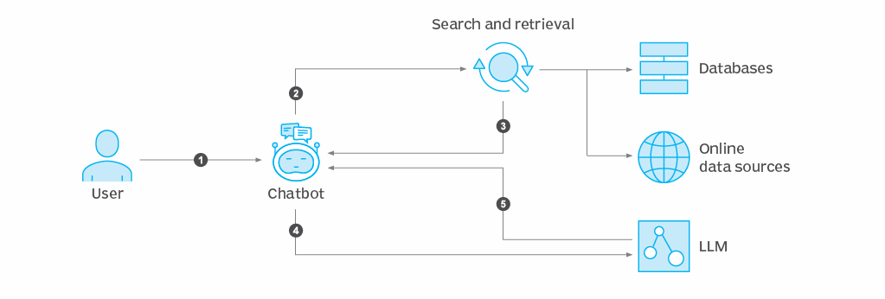
Architecture blueprint

Slide 9
Role of Agentic AI in your solution
Explain how Agentic AI help to find solution of the problem

Slide 10
Technology Used
Langflow platform
Langflow component name – Document Q&A , Chat input , Chat output
RAG

Slide 11
Novelty and Uniqueness
· First platform merging micro‑climate sensing, GenAI, and policy
retrieval for urban adaptation.
· Uses non‑wearable, rooftop nodes—cheaper and easier to deploy
city‑wide.
· Granite‑guarded outputs ensure bias‑free, regulation‑compliant
advice.
· 5‑second loop from sensor trigger to official alert.

Slide 12
Git Hub Link
https://github.com/aniket13thakur/fdp_rag_based_ai_agent_for_chronic_disease_monitoring.git

Slide 13
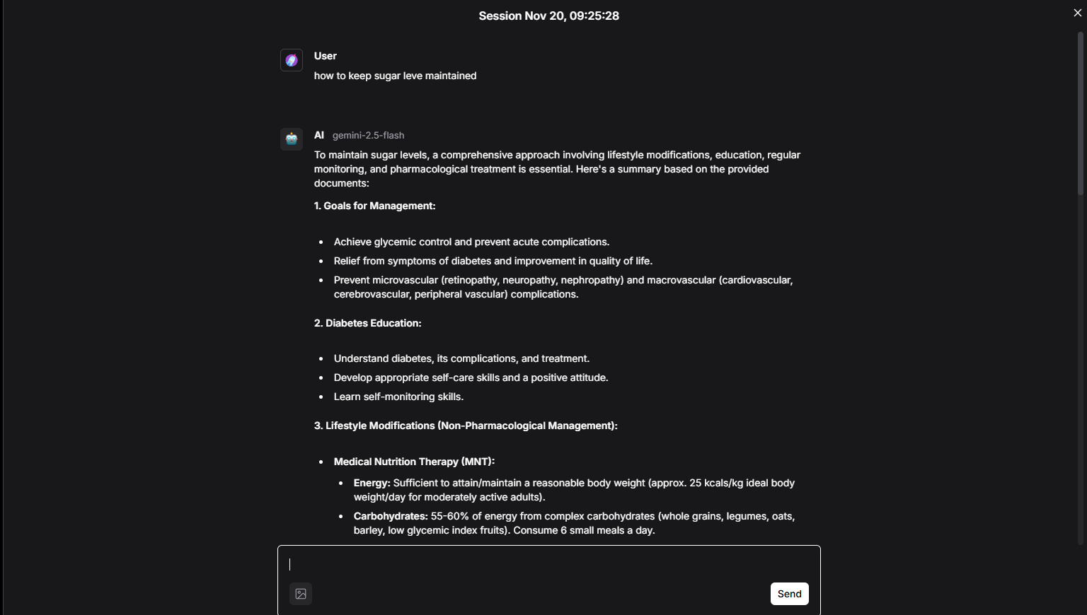
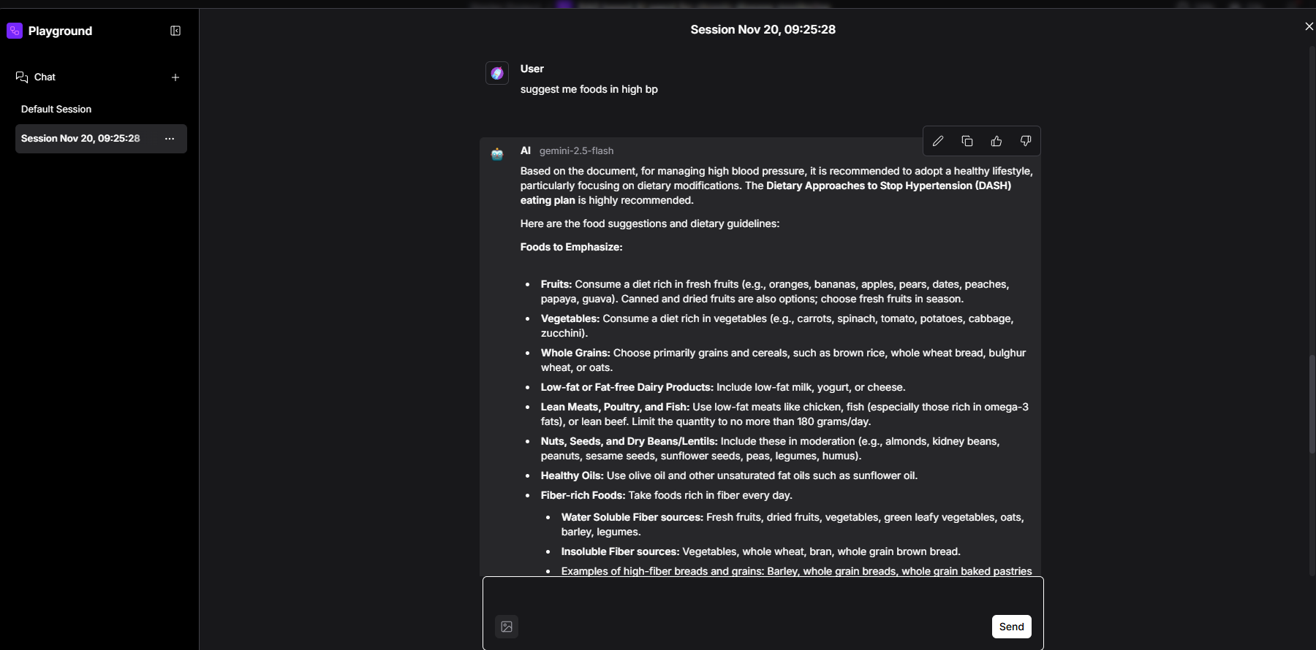
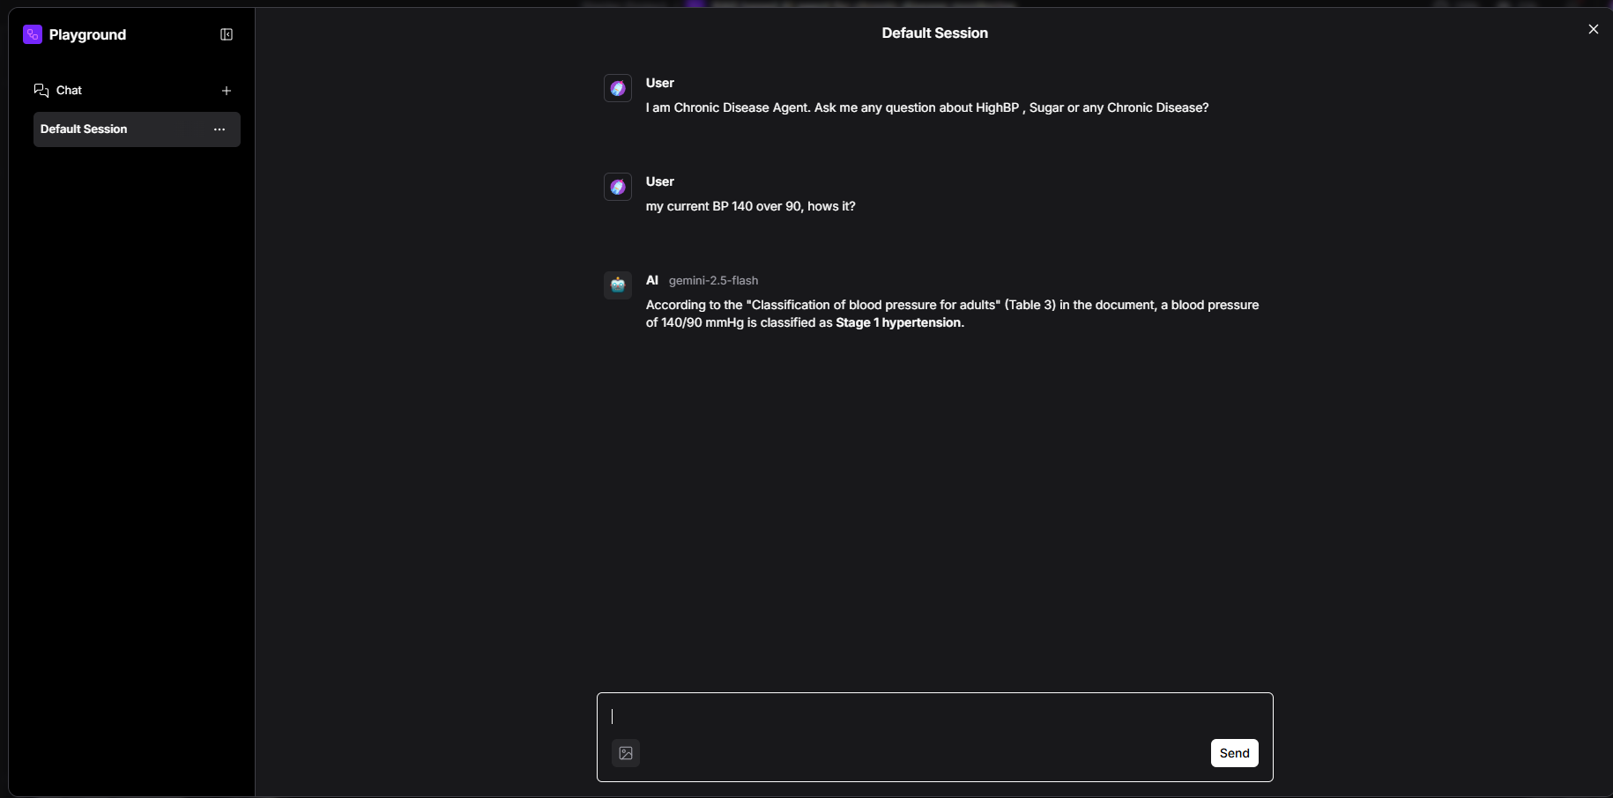
Output Screen shots
·
·
·

Slide 14
Future Scope
·We can add a chatbot that can support patient to solve their queries

Slide 15
References
https://sop.washington.edu/wp-content/uploads/Chronic_Disease.pdf
https://cinj.org/sites/cinj/files/documents/NutritionandChronicDisease_072612.pdf
·
·
·

Slide 16


